Slide 1
Financial capability for frontline workers
Unit 7: Dealing with clients with low English skills.

Slide 2
What are the most common scenarios involving clients with low English skills and low financial capability?

Slide 3
Financial abuse.
Benefits overpayment/underpayment.
Taxes/income.

Slide 4

Scenario 1
Sonia has poor English language. In her broken English she tells you her husband started using her salary to spend on cars six months ago. He used all their savings, and last week was declared bankrupt. She feels threatened by her husband who has been very angry.
She doesn’t know what to do.
What do you do?

Slide 5
Financial abuse
‘Abuse’ includes financial abuse …. [and that]… includes
having money or other property stolen;
being defrauded;
being put under pressure in relation to money or other property, and
having money or other property misused.
The Care Act 2014, s42(3)

Slide 6
How can you help Sonia?
Allow more time to talk.
Suggest having a new independent bank account.
Work with other services (police, social services, specialist advice services).
Always consider your client’s safety
Adapted from "Supporting clients in vulnerable circumstances" Money Advice Trust, September 2017.

Slide 7

Help with financial abuse
Women
Women’s Aid can offer help and support if you’re experiencing financial abuse.
Your local Women’s Aid organisation might also be able
to recommend a suitable solicitor if you need one.
You can find information on their websites or by calling
their helpline.
In England go onto the Women’s Aid website or call the freephone 24 hour National Domestic Violence Helpline (run in partnership between Women’s Aid and Refuge) on 0808 2000 247.

Slide 8

Help with financial abuse
Men
Men’s Advice Line
Call the Men’s Advice Line on 0808 8010 327.
It’s free from landlines and most mobile phones.
It provides emotional support, practical advice and can signpost you to other services for specialist help.

Slide 9
Vulnerable clients
What is vulnerability?

Slide 10
Financial Conduct Authority (FCA) Definition
[…a vulnerable consumer is] '…. someone who, due to their personal circumstances, is especially susceptible to detriment, particularly when a firm is not acting with appropriate levels of care’.

Slide 11
Consumer credit Sourcebook (CONC) Definition
“Most customers seeking advice on their debts [……] may be regarded as vulnerable to some degree by virtue of their financial circumstances. Of these customers some may be particularly vulnerable because they are less able to deal with lenders or debt collectors pursuing them for debts owed. Customers with mental health and mental capacity issues may fall into this category.” (CONC 8.2.8)

Slide 12
Who is at risk of detriment?
Those on a very low income.
Those who cannot access mainstream forms of lending.
Those who focus on affordability of repayments (low weekly amounts).
Particularly vulnerable are:
Those less able to deal with lenders/collectors.
Those with mental health conditions.
Those with a mental capacity limitation (dementia, learning disability,
brain injury).

Slide 13
Financial capability and vulnerability: clients with low English skills.
Types of people:
Poor English language
Possibly recently arrived to the UK
Under 35
Single
Social tenants
Unemployed
No qualifications

Slide 14
Referring and signposting
Suicidal clients:
Call 999
Samaritans
GP
Mental health worker
Accident and emergency
Other clients:
Depending on circumstances:
Police
Social services
Specialist advice services

Slide 15


Your doubts
Wiseradviser
www.wiseradviser.org
Once registered on the Wiseradviser website you can:
Book a free place on a face-to-face training course.
Start an e-learning course.
Access the range of Wiseradviser training and resources for continued professional development.

Slide 16
Exercise
Which bills do you pay first, when you have little money?

Slide 17

Bills
Pay first
The most important
Pay later

Slide 18
Bills
Pay first
The most important High priority
Pay later
Low priority

Slide 19
Bills
Non payment of high priority bills,
You could lose your home.
You could cut off.
You could get a fine.
Bailiffs could take your belongings.
You may not be able to take out any more credit.
Money could be taken off your benefits or wages.
You could be sent to prison.
Non-payment of low priority bills,
You could be taken to the County Court.
The County Court decides how you pay back your bill.
With CCJ – you may not be able to take out any more credit.
Bailiffs could take your belongings.
You cannot be sent to prison.

Slide 20

Scenario 2
A client received notice of seeking possession from the landlord. The client explains that he was unable to pay his rent due to suspension of his housing benefit. He has £3,000 in rent arrears.
What do you do?

Slide 21


Debt advice
National Debtline
Email advice from website:
www.nationaldebtline.org
Freephone 0808 808 4000
Monday to Friday 9am to 8pm
Saturday 9.30am to 1pm
For business owners get advice or webchat support from:
www.businessdebtline.org
Freephone 0800 197 6026
Monday to Friday 9am to 8pm
Giving free, impartial and confidential debt advice for over 25 years. It is an independent charity, dedicated to providing free debt advice by phone and online to people across the UK.

Slide 22

Money advice
Money Advice Service
www.moneyadviceservice.org.uk
Money Advice Line on 0800 138 7777
Typetalk 1800 1 0300 500 500
The Money Advice Service is independent and set up by government to help people make the most of their money by giving free, impartial money advice to everyone across the UK – online and over the phone.
They give advice, tips and tools on a wide range of topics including day-to-day money management, savings, planning retirement and future, as well as advice and help for life changing events such as starting a family or losing the job.

Slide 23

Your doubts and learning
Once registered on the Wiseradviser website you can:
Book a free place on a face-to-face training course.
Start an e-learning course.
Find out about the latest money and debt advice news, upcoming events and job vacancies.
Access the range of Wiseradviser training and resources for continued professional development.
Wiseradviser
www.wiseradviser.org

Slide 24

Debt advice and your doubts
Citizens Advice
www.citizensadvice.org.uk
Clients can get advice from the Citizens Advice network, including online, by phone and in person.
Citizens Advice aims to provide the advice people need for the problems they face and improve the policies and practices that affect people's lives.
Citizens Advice provides free, independent, confidential and impartial advice to everyone on their rights and responsibilities.

Slide 25
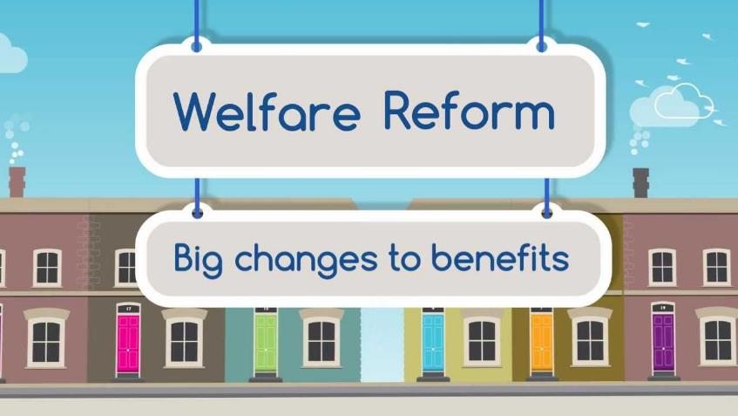

Slide 26
Welfare benefits reform
Universal Credit
PIP
Benefit cap
“Bedroom tax”

Slide 27
Scenario 3
Marcia lives with her parents. She is a single mother.
Her son is two years old. Marcia works full time and earns a low salary. Her father receives housing benefit and it is paid directly to the landlord.
Marcia is worried about what will happen when Universal Credit is fully in place, as her father is a compulsive gambler.
What do you do?

Slide 28
Universal Credit
What is it?
Single benefit replacing several existing ones.
It will be paid monthly.
You have to manage it yourself, online.
To access it you have to agree to a Claimant Commitment.

Slide 29
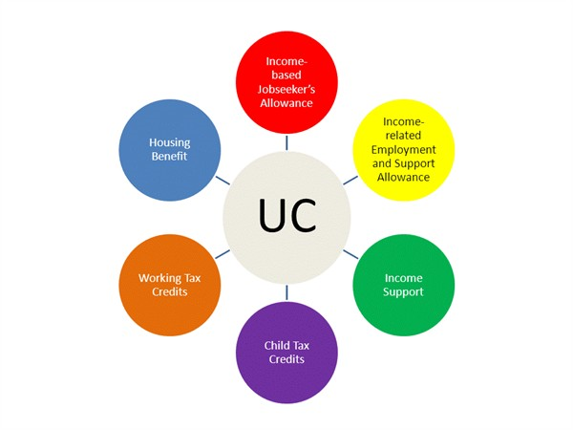
Universal Credit

Slide 30
Universal Credit
What is the client commitment?
Things that claimant has to do.
Four types of commitments.
Only one applies to the claimant.

Slide 31
Universal Credit
Commitment one: The work-focused interview.

Slide 32
Universal Credit
Commitment one: The work-focused interview.
Commitment two: The work preparation requirement.

Slide 33
Universal Credit
Commitment one: The work-focused interview.
Commitment two: The work preparation requirement.
Commitment three: The work search requirement.

Slide 34
Universal Credit
Commitment one: The work-focused interview.
Commitment two: The work preparation requirement.
Commitment three: The work search requirement.
Commitment four: The work availability requirement.

Slide 35
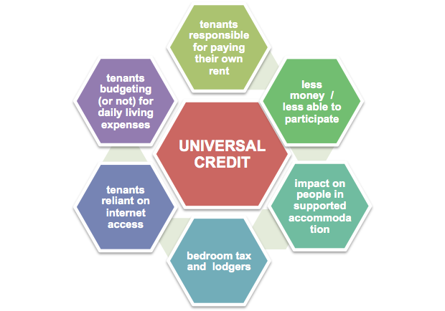
Universal Credit

Slide 36
Help with Universal Credit
Advice
Citizens Advice
Local Law Centres
Self-help
Turn2us: is a national charity that helps people in financial hardship gain access to welfare benefits, charitable grants, benefits calculator and support services.
http://advicefinder.turn2us.org.uk/
A list of advice organisations can be found under the tab “charities and intermediaries.”
Citizens Advice useful tool to check eligibility for Universal Credit:
https://www.citizensadvice.org.uk/benefits/universal-credit/before-you-apply/Check-if-youre-eligible-for-Universal-Credit/

Slide 37
Income and taxation

Slide 38
Income and taxation
Understanding payslips.
Tax codes basics.
Where to go for help.

Slide 39
Payslips
Right to a payslip:
“An employee has the right to be given,
“at or before the time at which any “payment of wages or salary is made to “him, a written itemised pay statement.”
“s8 Employment Rights Act 1996

Slide 40
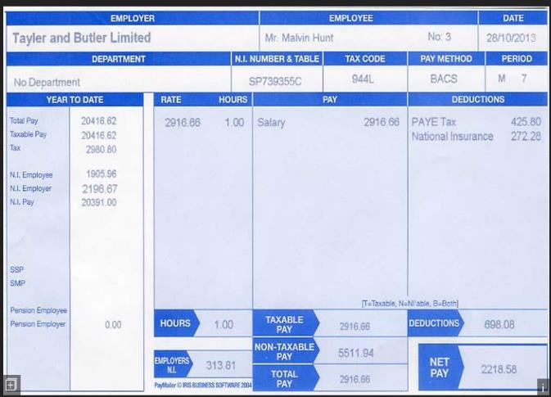
Payslips

Slide 41
Tax code
What is it?
A tax code is a code number used by your employer or pension provider to work out how much Income tax to take from your pay or pension.
HM Revenue and Customs (HMRC) will tell them which code to use to collect the right tax.
Source: https://www.gov.uk/tax-codes

Slide 42
Tax code
The amount of tax you pay depends on:
How much income you have.
How much tax you’ve already paid in the year.
And your Personal allowance.
Source: https://www.gov.uk/tax-codes

Slide 43
Tax code
The most common tax code for tax year 2018 to 2019 is 1185L.
1185L is an emergency tax code only if followed by ‘W1’, ‘M1’ or ‘X’.
Emergency codes can be used if a new employee doesn’t have a P45.

Slide 44
Tax code
Personal allowance 2018/19.
Band
Taxable income
Tax rate
Personal allowance
Up to £11,850
0%
Basic rate
£11,851 to £46,350
20%
Higher rate
£46,351 to £150,000
40%
Additional rate
Over £150,000
45%

Slide 45
Tax code
Exercise 1
An employee with the tax code 1185L
can earn £11,850 before being taxed.
If they earn £27,000 per year,
how much is their taxable income?

Slide 46
Tax code
Exercise 1
An employee with the tax code 1185L
can earn £11,850 before being taxed.
If they earn £27,000 per year,
how much is their taxable income?
Their taxable income is £15,150.

Slide 47
Where to go for help?
Your employer
Websites
  www.hmrc.gov.uk
  www.taxaid.org.uk (useful to resolve tax issues)
  www.litrg.org.uk (Low Income Tax Reform Group helps people on low incomes)
Fee-charging tax advisers:
  The Association of taxation Technicians
  The Chartered Institute of Taxation

