Slide 1

Payslips
Unit 6: Basic income and taxation

Slide 2
Payslips
Understanding payslips: income and taxation.
Tax codes basics.
Where to go for help.

Slide 3
Payslips
Right to a payslip:
“An employee has the right to be given by his employer, at or before the time at which any payment of wages or salary is made to him, a written itemised pay statement.”
s8 Employment Rights Act 1996

Slide 4
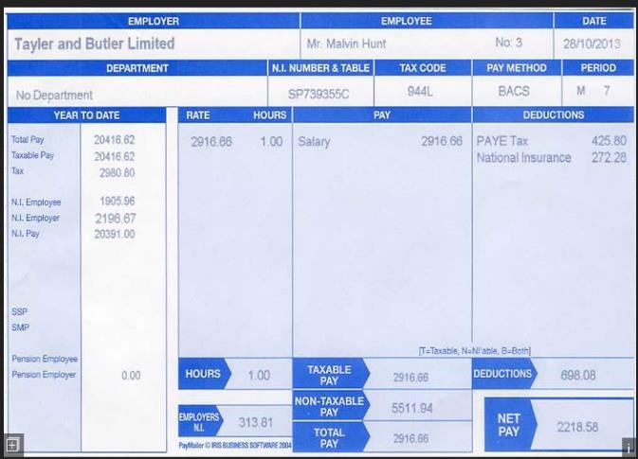
Payslips

Slide 5
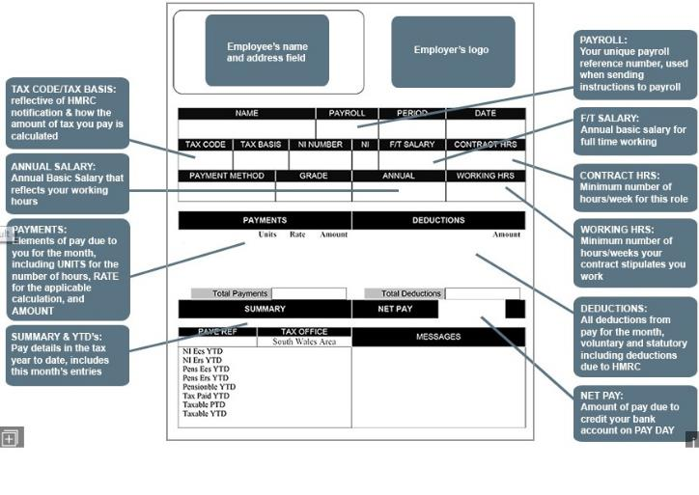
Payslips

Slide 6
Tax code
What is it?
It is a number used by your employer to work out how much income tax to take from your pay or pension.
HM Revenue and Customs (HMRC) will tell them which code to use to collect the right tax.
Source: https://www.gov.uk/tax-codes

Slide 7
Tax code
The amount of tax you pay depends on:
How much income you have.
How much tax you’ve already paid in the year.
And your personal allowance.
Source: https://www.gov.uk/tax-codes

Slide 8
Tax code
Personal allowance 2018/19.
Band
Taxable income
Tax rate
Personal allowance
Up to £11,850
0%
Basic rate
£11,851 to £46,350
20%
Higher rate
£46,351 to £150,000
40%
Additional rate
Over £150,000
45%

Slide 9
Tax code
The most common tax code for tax year 2018 to 2019 is 1185L.
1185L is an emergency tax code only if followed by ‘W1’, ‘M1’ or ‘X’.
Emergency codes can be used if a new employee doesn’t have a P45.

Slide 10
Tax code
Exercise 1
An employee with the tax code 1185L
can earn £11,850 before being taxed.
If they earn £27,000 per year,
how much is their taxable income?

Slide 11
Tax code
Exercise 1
An employee with the tax code 1185L
can earn £11,850 before being taxed.
If they earn £27,000 per year,
how much is their taxable income?
£11,850
£27,000
£15,150

Slide 12

Tax code
Exercise 2
Rob has a tax code K474 and a salary of £17,000.
His payslip shows that he has paid HMRC £125 for the last four months.
Rob thinks that this cannot be right but he doesn’t know where to go…

Slide 13
Tax code
Exercise 2
Rob has a tax code K474 and a salary of £17,000.
His payslip shows that he has paid HMRC £125 for the last four months.
Rob thinks that this cannot be right but he doesn’t know where to go…
Step 1: What is the taxable income on £17,000?

Slide 14
Tax code
Exercise 2
Rob has a tax code K474 and a salary of £17,000.
His payslip shows that he has paid HMRC £125 for the last four months.
Rob thinks that this cannot be right but he doesn’t know where to go…
Step 1: What is the taxable income on £17,000?
£11,850
£17,000
£5,150

Slide 15
Tax code
Exercise 2
Rob has a tax code K474 and a salary of £17,000.
His payslip shows that he has paid HMRC £125 for the last four months.
Rob thinks that this cannot be right but he doesn’t know where to go…
Step 1: What is the taxable income on £17,000?
The taxable income is £5,150

Slide 16
Tax code
Exercise 2
Rob has a tax code K474 and a salary of £17,000.
His payslip shows that he has paid HMRC £125 for the last four months.
Rob thinks that this cannot be right but he doesn’t know where to go…
Step 1: What is the taxable income on £17,000?
The taxable income is £5,150
Step 2: How much does he have to pay?

Slide 17
Tax code
Exercise 2
Rob has a tax code K474 and a salary of £17,000.
His payslip shows that he has paid HMRC £125 for the last four months.
Rob thinks that this cannot be right but he doesn’t know where to go…
Step 1: What is the taxable income on £17,000?
The taxable income is £5,150
Step 2: How much does he have to pay?
20% of £5,150 = £1,030
£1,030 divided by 12
= £85.83 monthly tax

Slide 18
Tax code
Exercise 2
Step 3: What is a tax code starting with ‘K’?
The letter K is used in an employee’s tax code when deductions due for company benefits, state pension or tax owed from previous years are greater than their personal allowance.
For example:
An employee has not paid
tax to HMRC when he was self-employed from 2014
to 2017. He owes £13,000, which is more than his personal allowance of £11,850.

Slide 19
Tax code
Exercise 2
So…
Rob is not aware that he owes anything to HMRC.
He has never had any company benefits.
He should be paying £85.83 per month according to his calculations…
He phones HMRC and finds out that he has been
allocated the wrong tax code.

Slide 20

Where to get help?
Your employer
Websites
  www.hmrc.gov.uk
  www.taxaid.org.uk (useful to resolve tax issues)
  www.litrg.org.uk (Low Income Tax Reform Group helps people on low incomes)
Fee-charging tax advisers:
  The Association of Taxation Technicians
  The Chartered Institute of Taxation

