Slide 1

Welfare benefits
Unit 5

Slide 2

Welfare benefits
Do you know the names of any benefits?
Where do you apply for them?
Who they might be paid to and when?

Slide 3
Welfare benefits
What benefits are there?
Jobseekers Allowance (JSA)
Council Tax Support / Reductions
Employment and Support Allowance (ESA)
Income Support
Disability Living Allowance (DLA)
Working Tax Credit
Attendance Allowance
Child Tax Credit
Housing Benefit
Universal Credit
Where do you apply for them?
Online
Job centre
Over the phone
Over the Post Office counter
By post
When might they be paid?
Daily
Weekly
Four weekly
Monthly
Annually

Slide 4

Welfare benefits
Child Benefit
You have dependent children.
The amount of Child Benefit you receive may be affected by the High Income Child Benefit charge if you or your partner earns more than £50,000 a year.
If you have recently arrived in the UK, you will have to wait three months before making an application in the most cases.

Slide 5

Welfare benefits
Housing Benefit
Help with your rent from your local council.
If you are on benefits or on a low income, you can apply.
The Government has put a cap on how much you can receive in benefits if you
and your partner are of working age but unemployed. This is known as the
‘benefit cap’.

Slide 6
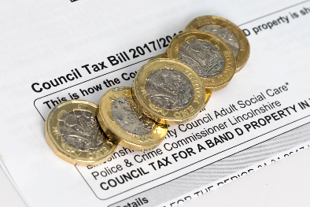
Welfare benefits
Support for Council Tax
Your local council runs a Council Tax Reduction Scheme. Contact them for details of how to apply.
If you live on your own, you may qualify
for a single person discount. Ask your
local council about this.

Slide 7

Welfare benefits
Child Tax Credit
People with responsibility for a child can apply. Children should be under 16, or under 20 if in full-time education.
You can apply whether you are in or out of work, unless you are being paid Universal Credit instead.
The amount you get depends on your income.

Slide 8

Welfare benefits
Working Tax Credit
For people who are in work.
You need to be on a low income.
By 2018 all new claims will be processed as Universal Credit instead of Working Tax Credit.
It is paid in addition your wages, and is dealt with by HMRC.

Slide 9
State benefit cap
The current cap is
£442.31 per week (£1,916.67 per month or £23,000 per year) for couples and lone parents in Greater London
£384.62 per week
(£1,666,67 per month or £20,000 per year) for couples and lone parents outside Greater London
£296.35 per week (£1,284.17 per month or £15,410 per year) for single adults in Greater London
£257.69 per week (£1,116.67 per month or £13,400 per year) for single adults outside Greater London

Slide 10
Universal Credit
What is it?
Single benefit replacing several existing ones.
It is paid monthly, in arrears.
You have to manage it yourself, online.
To get it you have to agree to a Claimant Commitment.

Slide 11
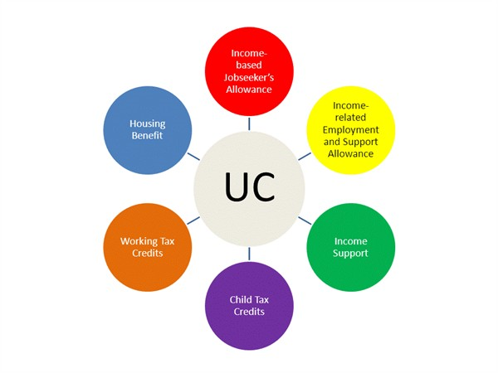
Universal Credit
Benefits being replaced by Universal Credit

Slide 12

Increasing your income
Things to check
Are you getting benefits and tax credits
or Universal Credit?
Is your employer paying you at least the
minimum wage?
Are you paying too much tax?
Can you get an advance, a budgeting loan
or help from your local council?
Can you cut your energy or water bills?

Slide 13

Where to go for help?
www.nationaldebtline.org
Freephone 0808 808 4000
www.turn2us.org.uk
Jobcentre Plus helpline:
0800 055 6688.
Tax credits helpline:
0345 300 3900 – www.gov.uk
Citizens Advice

