Slide 1

Banking
Unit 3

Slide 2
Available topics
Opening a bank account
Types of bank account
Overdraft
Bank statement
Bank accounts: advantages and disadvantages

Slide 3

How do you pay?
For shopping

Slide 4

How do you pay?
For bills

Slide 5
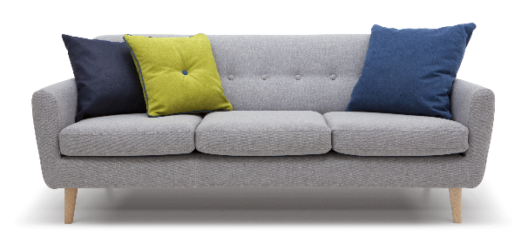
How do you pay?
For special items

Slide 6

Opening a bank account

Slide 7
Opening a bank account
Fraud and financial crime are rising. The bank wants to know:
Who you are and where you live.
Where your money comes from.
How you use your accounts.

Slide 8
Opening a bank account
Who you are
Valid full passport.
EEA or Swiss national identity card.
Valid UK driving licence.
Where you live
Valid UK driving licence.
Council tax bill.
Tenancy agreement.
Letter confirming your right to benefits from
Department for Works and Pensions, Jobcentre Plus.

Slide 9
Opening a bank account
…If you are new to the UK
Letter from your employer
  confirming that you are employed by this employer;
  dated within the last three months;
  letter must be on headed paper.

Slide 10
Opening a bank account
…Steps
Choose a bank account.
Complete the application form. The bank will check
your banking and borrowing history.
Submit proof of address and identity.

Slide 11
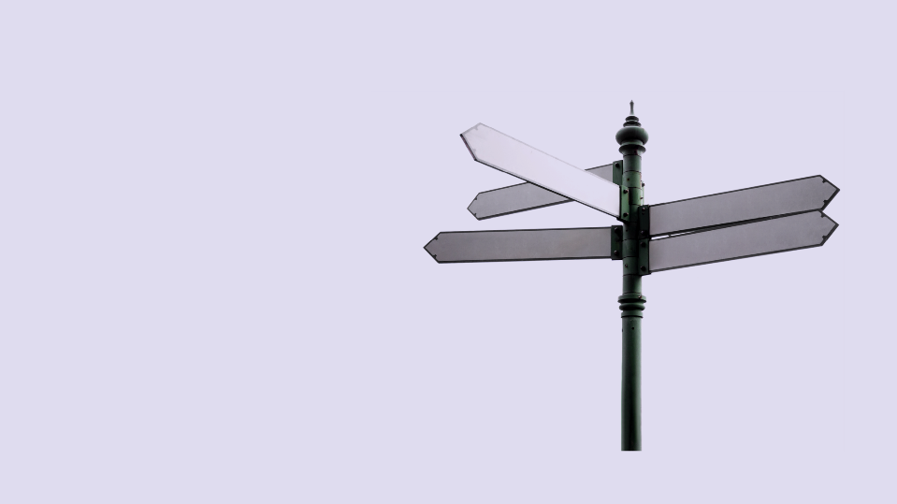
Types of
bank account

Slide 12
Types of bank account
Basic Account
Current Account
Packaged Account
Savings Account
Post Office Card Account
Credit Union Account

Slide 13
Which account is better for Rob?
Rob is a single parent of three children under 16.
He receives benefits and has bills to pay every month.
Rob has a Post Office Card and uses the local post office to
cash his benefits.
However, the branch is going to close and the nearest branch is more than a mile from his home.
Which account is better for Rob?

Slide 14

Overdraft

Slide 15
Overdraft
What is an overdraft facility?
Credit
Advance
It is when you draw more money from
your bank account than you have in.

Slide 16
Overdraft – Exercise 1
Rob has a bank account balance of £230.
He pays £270 for clothing and shopping.
Q1. By how much is Rob overdrawn?

Slide 17
Overdraft – Exercise 2
He has an arranged overdraft of £50 and a buffer of £10.
Q1. Identify these on the graph.
Q2. What happens to the money overdrawn?

Slide 18
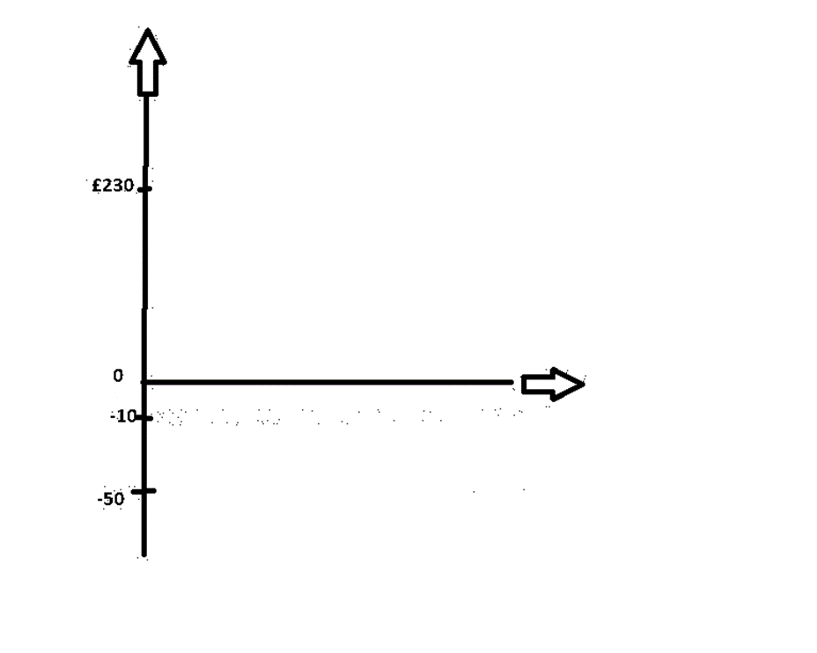
Overdraft – Exercise
Where are the buffer and
the overdraft zones?

Slide 19
Overdraft example
 | Classic Account
High street bank | Account free & requirements | Arranged overdraft | Interest rate
 | No monthly fee. | £25 interest free with a £10 buffer, then £6 per month & 19.84% EAR variable. | 0% AER.

Slide 20
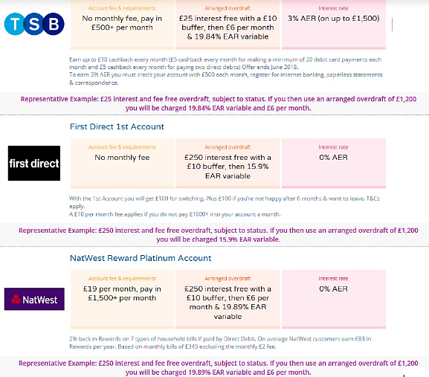
Overdraft comparison
Bank 1
Bank 2
Bank 3

Slide 21
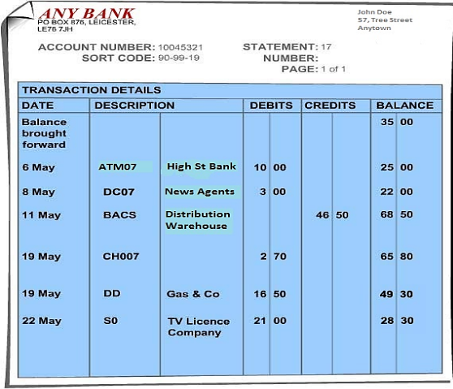
Bank statement
Adapted: http://www.moneymatterstome.co.uk/4-financial-records-and-information/sub1/bankstatement.htm

Slide 22

Bank account: why have one?

Slide 23

Bank account - advantages
Direct debit

Slide 24
Bank account - advantages
Direct debit
Online banking

Slide 25
Bank account - advantages
Direct debit
Online banking
Overdraft

Slide 26
Bank account - advantages
Direct debit
Online banking
Overdraft
Instant access

Slide 27
Bank account - advantages
Direct debit
Online banking
Overdraft
Instant access
Standing order

Slide 28
Bank account - advantages
Direct debit
Online banking
Overdraft
Instant access
Standing order
Debit card

Slide 29
Bank account - advantages
Direct debit
Online banking
Overdraft
Instant access
Standing order
Debit card
Credit card

Slide 30
Bank account - advantages
Direct debit
Online banking
Overdraft
Instant access
Standing order
Debit card
Credit card
Cheque

Slide 31

Bank account - disadvantages
Tax credits/benefits may make mistakes and stop payments.

Slide 32
Bank account - disadvantages
Tax credits/benefits may make mistakes and stop payments.
Small print and wording difficult to understand.

Slide 33
Bank account - disadvantages
Tax credits/benefits may make mistakes and stop payments.
Small print and wording difficult to understand.
Getting acceptable identification.

Slide 34
Bank account - disadvantages
Tax credits/benefits may make mistakes and stop payments.
Small print and wording difficult to understand.
Getting acceptable identification.
Dealing with call centres.
Fraud.

