Slide 1

Which bills to pay first?
Unit 1: When you have little money.

Slide 2
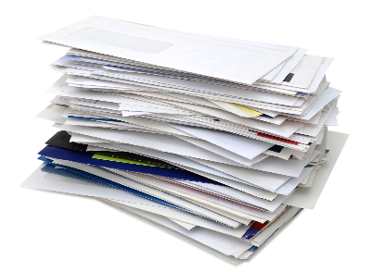
Bills
Pay first
Pay later

Slide 3
Bills
Pay first
The most important High priority
Pay later
Low priority

Slide 4

What happens if you don’t pay high priority bills?

Slide 5

Consequences
You could lose your home.
You could be cut off.
You could get a fine.
Bailiffs could take your belongings.
You may not be able to take out any more credit.
Money could be taken off your benefits or wages.
You could go to prison.

Slide 6
Which high priority bills? Which consequences?

Slide 7
Which high priority bills? Which consequences?
1
Rent
Mortgage
Secured loan
2
Electricity
Gas
Phone
3
TV Licence
Council tax
Maintenance
Magistrates’
court fine

Slide 8
What happens if you don’t pay low priority bills?

Slide 9

Consequences
You could be taken to the County Court.
The County Court decides how you pay back your bill.
With CCJ – you may not be able to take out more credit.
Bailiffs could take your belongings.
You cannot be sent to prison.

Slide 10
Bills
Non payment of high priority bills,
You could lose your home.
You could be cut off.
You could get a fine.
Bailiffs could take your belongings.
You may not take out more credit.
Money could be taken off your benefits or wages.
You could go to prison.
Non-payment of low priority bills,
You could be taken to the County Court.
The County Court decides how you pay back your bill.
With CCJ – you may not be able to take out more credit.
Bailiffs could take your belongings.
You cannot be sent to prison.

